Slide 1
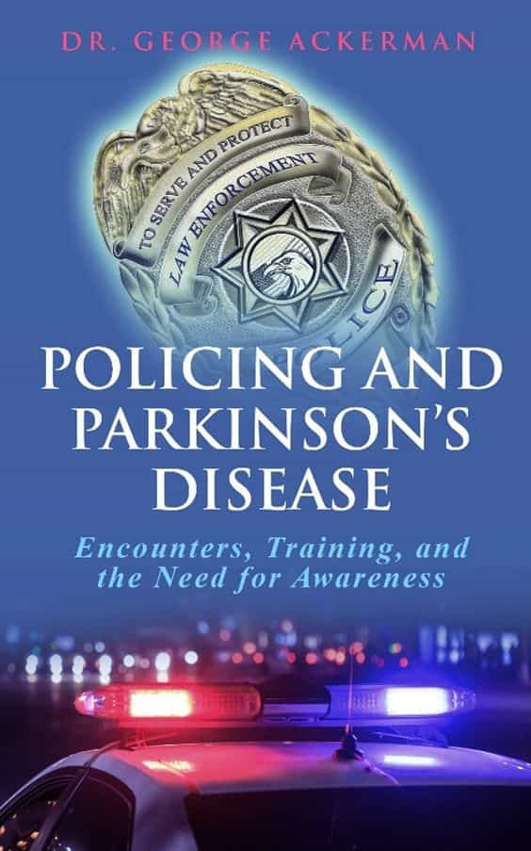


Policing and Parkinson’s Disease: Encounters, Training, and the Need for Awareness
Dr. George Ackerman
PhD – Professor of Criminal Justice
Attorney, Police Officer, Rsv.,

Slide 2

-Richard Dewey, Department Chair, Criminal Justice, Indian River State College. Former MSgt-Chief Investigator, USMC; Detective- Port St Lucie Police Department.
Dr. Ackerman’s focus on equipping law enforcement professionals with the knowledge and skills to approach encounters with PwP thoughtfully and effectively is not only timely but essential. This work has the potential to shape how academies train recruits, influence ongoing officer education, and reduce anxiety for individuals with PD during police interactions. I highly recommend this book to academics, police organizations, and policymakers committed to fostering greater understanding and more effective community engagement in law enforcement.

Slide 3
Dedication
Dedicated to the entire law enforcement community
and Parkinson’s community
because we are in this fight together
for awareness and hope for a cure.
---------------------------------
Dedicated Also to the memory of my mother,
Sharon Riff Ackerman,
who suffered with Parkinson’s disease for 15 years.
My family and I started TogetherForSharon® to keep alive the memory of my mother and to share the message of Parkinson’s awareness and hope for a cure.
https://www.togetherforsharon.com/

Slide 4

My Mother... Sharon
The book is a heartfelt and often heart-wrenching recollection of the beginnings of her Parkinson’s disease symptoms to the inevitable end. This book, too, is primarily for relatives and caregivers of those with Parkinson’s.
However, I also want to reach those who are not aware of Parkinson’s throughout the world. Until we ensure that others outside the local or regional Parkinson’s community are made aware, a cure will be further from our grasp. Others, too, may find the book helpful, especially for those suffering from associated diseases.

Slide 5

Michael J. Fox

Slide 6

Parkinson’s Disease
Are you Aware?
Do you know the symptoms?
Why is it important for law enforcement to be aware?
Should training add the words “Parkinson’s Disease” across the country? (My Dream)

Slide 7

Chapter 1: An Encounter of Amanda, A Person with
Parkinson’s (PwP) and the Police
“I woke up on a Sunday morning in late April, and I was feeling pretty good that day. My tremors were calm, and I thought, I’ll just go do a couple of things. I need to go to Walmart and put gas in the car.
“Opening the door to my car, I got in and adjusted my seatbelt. Then I noticed that a cop had pulled up behind me. I hadn’t even started the car. He got out of his patrol car and walked to my door. I opened it and was about to say hello when he said he’d gotten a call that someone was drunk at the gas station at pump 10. I had been at pump 10.
“I told him no I was not drunk but that I have Parkinson’s. So, I asked him what I needed to show him to prove that I have Parkinson’s and took my pills out of my purse to show him. But he decided he wanted to do a breathalyzer.
“I understand that the cop was doing his job but, seriously, to call for two additional cops after I told him that I just had Parkinson’s. That was overboard. I know when I can and cannot drive and don’t drive when I am having a bad day. That was a good day for me.
“This encounter made me realize that people—including policemen—do not understand this disease. So, I limit my time in public. Now, I don’t go out unless it’s early in the morning so not many people are out. I don’t eat in restaurants anymore. People stare. And I just get tired of it all. We really, really need more awareness!”
--Amanda, Scottsbluff, Nebraska

Slide 8
Why Policing and PD?
I have become an unrelenting researcher and advocate for PD awareness and have published a second book of interviews with PwP and other committed individuals, Voices of Resilience: Conversations with Parkinson’s Disease Warriors, Caregivers, and Advocates (Ackerman, 2024b).
I am also a police officer (see Chapter 2 for more). I attended the Miami-Dade County Police Academy in 2006 and in that year graduated and became a fully sworn police officer in Florida. I have been active as a reserve officer from that year to the present.
And in my duties, I have noticed a significant omission: the lack of officers’ knowledge and awareness of PD and how to handle it with citizens. So, this book is meant to inform and guide not only officers but also PwP (Person or People with Parkinson’s) in how to respond and act in the way that will produce the best and most humane outcome.

Slide 9

Research & Results
I have sought out and reviewed hundreds of journal articles, other scholarly literature, and websites, and they all show a lack of research and findings on the critical topic of PD.
Parkinson’s affects over one million people diagnosed in the United States and millions of their caregivers who are concerned about treatment, care, and awareness by the criminal justice field toward their loved ones.
The data are absent, rare, or unfounded. Issues such as care, safety, and outcomes from police encounters are troublesome and even frightening.
This lack is very concerning and easily leads to a significant negative incident between a PwP and police through untrained response to a call or scene.
Awareness of bad judgment and proper, thorough training can thwart poor training and detrimental responses by police.

Slide 10
People With Parkinson’s
According to the World Health Organization (2023), “globally, disability . . . due to PD is rapidly increasing” (para. 1) which can precipitate more encounters between law enforcement and PwP worldwide.
1
As rates grow, so does the need for training and PD awareness for academy trainees and field officers. The likelihood of an encounter or interaction between police and PwP grows as more PwP are diagnosed.
2
Thus, awareness is needed when approaching a PwP in a vehicle, at their home, or in any interaction in daily activities.
3
Creating new policies for training and PD awareness can help policymakers, health program managers and planners, healthcare providers, researchers, carers, and other stakeholders so that all are informed when PwP and those helping them interact with police.
4

Slide 11
Impact Across America
The impact would benefit PwP, the policing field, and all communities.
It will lower national attention of potential incidents through media of potential violations of individual rights; it will improve awareness for PD throughout the country and benefit society as a whole to include PD in basic training for all police academies in the United States as well as offering in-service training for sworn law enforcement officers and administrators.
PD can affect anyone, and when it does, it, in turn, affects the family, neighbors, and entire community.
The more we become aware, the more likely we can find a cure and better aid trainees, officers, and PwP on the critical relationship needed for professionalism and positive outcomes in any encounter or situation.

Slide 12
Any Downsides to PD Awareness?
There is no downside to bringing attention and awareness to PD in the law enforcement community.
The cost is truly minimal.
Even adding the term PD, listing symptoms, and defining PD in all training manuals at the police academies, and adding the term and definition to sworn officer training, manuals, and Standard Operating Procedures would help change how officers react and proceed during encounters with PwP.
If needed, the passing of legislation in every state to incorporate information about PD into all police department training and manuals would immeasurably improve police-PwP relations.
The initiative needs to be nationwide.

Slide 13

Chapter 3: The Signs and Symptoms of
Parkinson’s Disease
Mayo Foundation for Medical Education and Research (2024) and NIH National Institute on Aging (2022).
Bradykinesia (Greek “Brady” = slow, “kinesia” = movement): This is slowness of movement that is a hallmark of PD. Everyday tasks, like walking, getting up from a chair, or writing, become more difficult.
Changes in speech: Speech becomes soft, slurred, or monotonous, and speech patterns change.
Changes in writing: Handwriting may become smaller and more cramped, known as micrographia.
Difficulties in chewing and swallowing.
Fatigue, difficulties sleeping.
Irritability, anger, violence: Behavior changes such as these may occur in the later stages and often result from the frustrations of the illness and loss of functions.
Elimination problems: Urinary problems, constipation.
Loss of automatic movements: Loss can manifest in difficulty with unconscious movements, such as blinking, smiling, or swinging arms while walking.
Muscle rigidity: Muscles become stiff or contracted for a long time. The stiffness or inflexibility of the muscles can cause pain and limit the range of motion.
Nonmotor and emotional symptoms: These symptoms include depression, anxiety, sleep disturbances, cognitive changes.
Postural instability: Impaired balance and coordination lead to difficulty maintaining an upright posture and an increased risk of falls.
Tremors in head, jaw, hands, arms, legs. Typically, a resting tremor is a rhythmic shaking or quivering of a body part, often starting in the hands.

Slide 14
The Five Stages of PD
PD symptoms usually begin gradually and worsen over time. Today, medical authorities agree on the five stages of PD (National Institute on Aging, 2022; WebMD, 2021). The duration can be short or long.
In the first stage, the symptoms are mild and hardly interfere with everyday living. If anything, symptoms may show on one side of the body, such as tremors. Sometimes, the person experiences detrimental changes in posture, walking, and facial expressions.
In the second stage, the symptoms become worse. The person may experience aggravated tremors or both sides of the body may become rigid. Sometimes, the neck and torso are affected. Walking is also harder. The person can still live alone but has difficulty with daily activities.
In the third stage, the person is more prone to losing balance and falls. Daily tasks can still be performed, but they are more difficult. This stage is considered “mid-stage” by experts, who label the disability mild to moderate, even though the person can still function independently.
In the fourth stage, the symptoms worsen. Standing and walking can still take place but people often use canes or walkers for steadiness and alleviation of falls. Living alone is impossible now; people need help with daily activities and tasks.
In the fifth stage, the most debilitating, leg stiffness may prohibit standing or walking. Appetite decreases radically, and the person lives in a wheelchair or bed and needs round-the-clock care (Cherney, 2021).

Slide 15
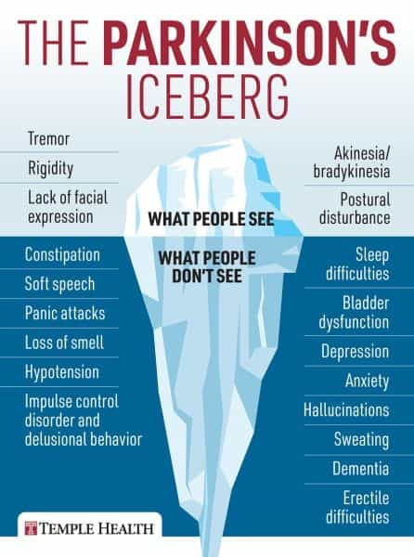

Slide 16
Chapter 12.
Where Is Police Training for Parkinson’s?
As part of the research for this book, I contacted police academies in all 50 states throughout the United States: Alabama, California, Colorado, Georgia, Louisiana, Maine, Maryland, Massachusetts, Michigan, Mississippi, Missouri, Nebraska, Nevada, New Hampshire, New Jersey, New York City, North Carolina, Oregon, Pennsylvania, South Dakota, Texas, Utah, Virginia, and Washington.

Slide 17
Federal, State and Local: Departments, Agencies & more..
In Miami, Florida, as mentioned, in the basic recruit manual Parkinson’s disease is not mentioned at all. The section on the elderly includes only dementia and Alzheimer’s disease.
According to the Colorado Peace Officer Standards and Training (POST, 2024), courses include interacting with people with disabilities but there is no specific training for Parkinson’s disease. I was informed by a training officer that “Colorado Police Officer Standards and Training only regulates the academy curriculum and minimum required hours for active officers. So individual agencies could be doing training above and beyond what we require” (personal communication, May 7, 2024).
A representative of the Michigan Public Information Officer Section-Law Enforcement, Communication and Outreach Division responded, “Our training is more generalized to take into consideration the possibility of health and mental factors when speaking with members of the community or responding to incidents. This would include many things like autism, mental health, diabetes, and Parkinson’s” but the literature does not specifically state Parkinson’s disease (personal communication, May 11, 2024).
The St. Louis, Missouri, Metropolitan Police Department (2024) covers a wide array of services and resources as well as requiring individuals to pass the state official police academy. An officer provided this response: “As far as in-service training for officers, our Critical Incident Training does cover related content but not specifically Parkinsons disease to my knowledge”

Slide 18
And the Research shows…
The Associate Dean of Salt Lake Community College, Utah, Institute of Public Safety and Criminal Justice, Cecile Delozier, admitted that “lesson objectives in our training manual and Parkinson’s is not specifically covered. There are other mental and neurological disorders/diseases but not Parkinson’s” (personal communication, May 11, 2024).
Dean Delozier further stated that she has not been impacted directly by Parkinson’s and is not aware as to how it impacts people’s actions or how it presents in stressful situations. Nevertheless, she was extremely helpful and agreed that this research is important to bring awareness to trainees and more widely into the policing field.
The Northern Virginia Criminal Justice Academy (2024) in Ashburn combines agencies, including police and sheriff offices, as well as training for officers which focus on potential candidates’ certifications for sworn police and for those currently sworn to maintain their certification. This academy provides Crisis Intervention Training for mental health issues, such as autism. However, I could find no material for specific training for Parkinson’s disease or PwP.

Slide 19
Chapter 13.
Avoiding Tragedy
Scenario…
Imagine it is about 3:00 a.m. A man is driving home from a late-night visit with family. His driving is a little erratic, and he is weaving in and out of a lane. Two policemen are waiting in a patrol car at a light when they see the driver and, noticing the weaving and as justified under the law, proceed to initiate a traffic stop. The patrol car drives behind the civilian’s car with lights flashing and sirens blaring.
As the driver pulls over, one officer approaches and shines his light through the window, standard procedure for the safety of both officers and the driver. The driver is showing uncontrollable movement with his arms. The officer, having relied on training, thought it could be a DUI or even worse, a crime being committed by the driver, such as driving under the influence of alcohol or a narcotic. The officer must take precautions for his safety and says in a commanding voice, “Keep your hands on the steering wheel.” But the driver cannot comply and his arms flail about.
Suddenly, a backup patrol car arrives with another officer (the first officer called for backup). The secondary officer cautiously approaches the passenger window, his gun drawn.
The driver tries to explain, but the officers remain convinced that a crime has just taken place or is about to. We can be sure the driver, whose uncontrollable arm movements are a result of his Parkinson’s, is confused, anxious, and afraid and can hardly speak………….

Slide 20
Chapter 15.
Law Enforcement Officers’ Experiences
With People With Parkinson’s
I sent out 45 emails of invitation to participate, and 35 officers responded, of whom 25 participated in completing the questionnaire (response rate 44%). The interviews took place from February 2023 to November 2025.
  The Questionnaire: Police Officers, Deputies, and Agents
1. Please provide your name (anonymous if preferred)
2. Your title
3. How many years in the field have you worked in law enforcement?
4. Have you ever encountered someone with Parkinson’s disease?
5. Have you had any training with PwP (People with Parkinson’s)?
6. Would adding training in the academy and in service help for police encounters with the Parkinson’s community?
7. What could the added training for PwP include?

Slide 21
Justin, Police Officer and Training Sergent, Police Municipality in Miami Dade County, Florida
“I have been an officer for 18 years. I trained in Miami. My background and training were approximately 8 years of doing traffic investigation. Then I moved to criminal investigations for 4 years and was finally promoted to Sergeant, and then I took over a patrol squad for a couple of years. I am not currently the training coordinator for my department.
“I do not know anyone personally with Parkinson’s disease and have not seen much about the disease in my career in law enforcement. In the academy, I never had any information provided during the 10 months of part-time schooling at the police academy. As a sworn officer, I have done a lot of mental health training, but nothing specific with Parkinson’s or PwP.
“It would benefit the officers and community if training were offered for academy trainees and sworn officers through in-service training. I support adding PwP training because we teach new trainees to be aware of it. Still, we do not do enough to treat people as humans, and adding more training for PwP and PD would benefit the officers, department, and entire community. Adding neurological disorder training would significantly impact future and current officers in the field today.”

Slide 22
Palm Beach Sheriff’s Deputy, K-9 Unit
“I have worked in the field for 20 years. I have not had any encounters with someone with PD that I am aware of. I have had to deal with other disabilities such as autism because I work a lot with search and rescue. Also, I have training with people with dementia and Alzheimer’s.
“I haven’t had any training with PwP. I think we concentrate more on people with autism, mental disabilities, and ADHD. I don’t recall a specific training with PD. If I see someone shaking, I realize they may feel worried or in fear, but it is difficult to know how to respond if you haven’t been in the field for many years. In academy they could add PD to the curriculum” (personal communication, May 18, 2024).

Slide 23

Steps for Police to Follow With PwP
Officers should follow regular training protocol. If they observe an individual who seems to be lost or wandering or a vehicle veering or swerving, officers should look for signs of PD, as learned. The officers I interviewed stressed that all officers should be informed and even take a few moments to review PD symptoms and effects. This review could not only halt or deflect escalation but save a life.
Officers should ask questions before coming to conclusions, especially regarding misconceptions. Attentiveness and respect for the PwP’s potential condition are essential. Some movements may be involuntary, and officers should be aware of this symptom.

Slide 24

Chapter 16.
People with Parkinson’s Experiences
With Law Enforcement Officers
I contacted potential participants with an invitation by email and sent out 30 invitations. The 10 PwP (response rate 33%) who responded and volunteered to speak with me completed the questionnaire and then agreed to a phone interview, in which I documented each response. I also posted several times on social media and have a following of over 4,000 people.
Of the respondents, 4 had been diagnosed with PD for over 5 years, 3 with PD for over 10 years, and 3 with Young Onset Parkinson’s from ages 30-50 (Question 2). Eight of the 10 had had negative interactions with police and today fear the police (Question 3). All 10 stated they believed police should add training to the academy courses and sworn officer in-service courses on PwP and symptoms (Question 4). All 10 also pointed out that they might not fear police if they felt officers were more aware of PD and its manifestations.

Slide 25
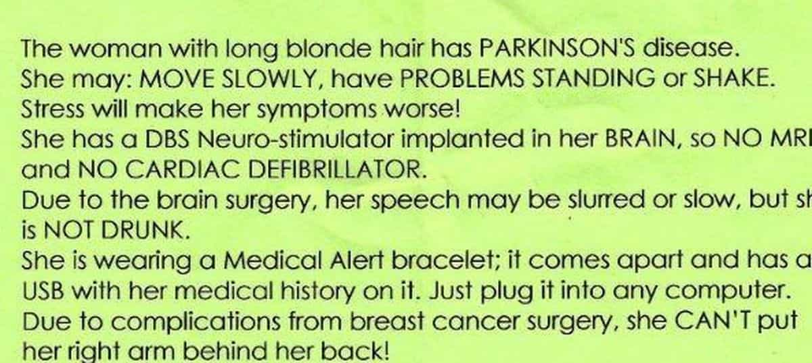
Beverly, A PwP
Beverly wrote that she carries a sheet on brightly colored paper with her Parkinson’s symptoms and emergency contacts listed (see also Parkinson’s Foundation medical card, Appendix A). This sheet is specifically for any encounters with police, emergency services, or first responders. She keeps the sheet in her car in a clear plastic sleeve with her registration and insurance card. She also has a sheet in her purse and one in her friend’s car in case she is driving her friend’s car.

Slide 26

Another Anonymous PwP and Police Interaction
“I was diagnosed on August 18, 2020. And my encounters with the police have been neutral, but not pleasant. I feel there is a big need for training for police. Not only for the police officers, but for people in general. Because this isn’t the first time that someone has thought I was intoxicated due to my PD symptoms. At my job I did have a couple of people at work who saw my symptoms and told me that I was intoxicated.
“Training for police when approaching or encountering PwP could mean not making things more stressful than they already are. When was I approached by a police officer, I was waiting for my daughter and brother at a public area in my community and had uncontrollable tremors. The officer kept asking me, probably 10 times, if I needed medical attention. The more he asked the more stressed I got, and my tremors got worse. And, by the time he was done asking me, two additional cops showed up—three all together. But one must have recognized the tremors as PD, and I am grateful to say that the issue was resolved without further escalation. They wished me well and left.

Slide 27
Observations
You can see from these experiences that the negative and positive encounters of PwP with police vary from person to person.
But differences can certainly be noticed between a PwP and a citizen who is not diagnosed with PD or displays PD symptoms.
In the negative experiences related here, the PwP were not belligerent or angry but very civil and reasonable. Most offered proof, either from a card with their license and registration or an invitation to call their physicians.
The officers varied in understanding, respect, and belief in what the PwP were saying.
Some officers were downright suspicious and would not listen to the explanations, and others were profoundly respectful and even caring.

Slide 28

Chapter 18.
Research and Important Legislation on Parkinson’s
Local Legislation
Below is the State of New Jersey Parkinson’s Disease Public Awareness and Education Act (2014).
The Legislature finds and declares that under the Parkinson’s Disease Public Awareness and Education Act
National Legislation
The National Plan to End Parkinson’s Disease is a breakthrough in the legislative process signed into law on July 2, 2024, President Biden.

Slide 29

Chapter 20.
Parkinson’s Programs to Help Police and Other First Responders
The American Parkinson Disease Association
https://www.apdaparkinson.org/
Parkinson’s Foundation
https://www.parkinson.org
Michael J. Fox Foundation
https://www.michaeljfox.org
TogetherForSharon®
https://www.togetherforsharon.com/

Slide 30


To purchase a copy and support PD awareness & Hope for a cure….
https://www.togetherforsharon.com/policing-and-parkinsons-disease-encounters-training-and-the-need-for-awareness/

Slide 31
RESOURCES/VIDEOS
Gait impairments in Parkinson's disease
https://www.youtube.com/watch?v=pFLC9C-xH8E
Early Signs of PD
https://www.youtube.com/shorts/Z7fp3QZ4cX8
Early Parkinson's Disease
https://www.youtube.com/watch?v=BNzIaABFAMc&t=48s
Parkinson's Disease Freezing & Festinating Gait
https://www.youtube.com/watch?v=EQ0HG16EC3g

Slide 32





PD Warriors & Celebrities
Celebrities have joined us in the fight for a cure including Kenny G, Michael J. Fox, Brett Favre, Jack Osbourne, Lea Thompson, Ric Flair, Rasheda Ali, Bernie Kosar, Michael Buffer & Many more!
https://www.togetherforsharon.com/pd-warriors-celebrities/

Slide 33
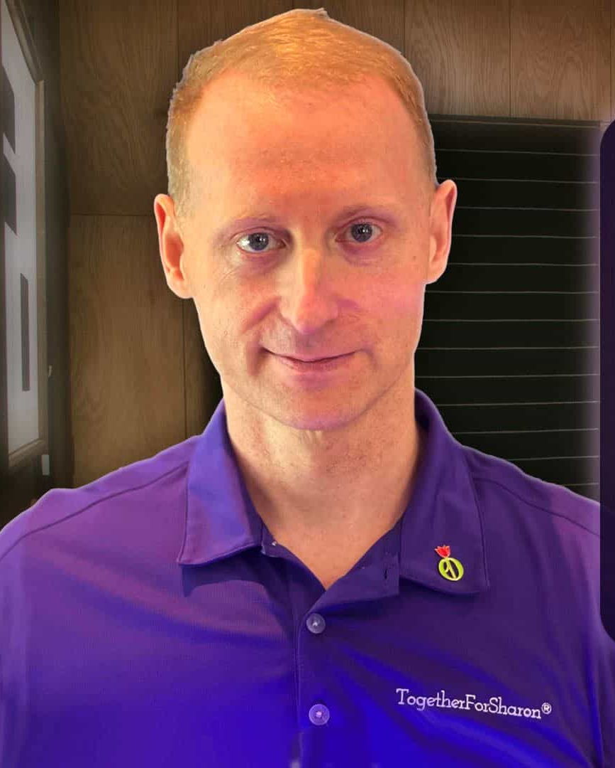
Join us in this MOVEMENT!
Share Share and Share!
Q & A with Sharon’s son, George – Podcast
A one-on-one question and answer show Hosted by Sharon’s Son, George for awareness, hope for a cure & to share inspiring journeys, advocacy, and support throughout the world.
https://www.togetherforsharon.com/qa-with-sharons-son-george/

Slide 34

The TogetherForSharon Podcast
Hosted by Sharon’s daughter in law, Grether & Sharon’s Son, George for awareness, hope for a cure & to share inspiring journeys, advocacy, and support throughout the world.
https://www.togetherforsharon.com/podcast-interviews/

Slide 35


Slide 36
Thank you
In memory of Dr. Ackerman’s mother, Sharon Riff Ackerman, he founded the website https://www.togetherforsharon.com/ to increase Parkinson’s awareness and research toward a cure. His dedicated interest in and passion for this work continues undiminished.
QUESTIONS? togetherforsharon@gmail.com

Slide 37
TogetherForSharon®
Copyright ©2025 George M. Ackerman
https://www.togetherforsharon.com/
We started TogetherForSharon® as a family for the purpose of keeping my mother, Sharon’s, memory alive and to share the message of Parkinson’s Awareness and hope for a cure.

