Slide 1
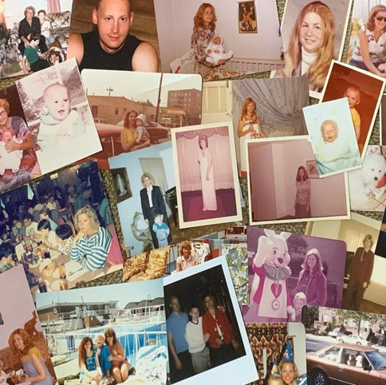
Dr. George Ackerman, PhD, JD “A Son’s Journey”
From Parkinson’s Disease Caregiver to Advocate.
In memory of my Mother, Sharon
TogetherForSharon®
https://www.togetherforsharon.com

Slide 2
Purpose
The book is a heartfelt and often heart-wrenching recollection of the beginnings of her Parkinson’s disease symptoms to the inevitable end. This book, too, is primarily for relatives and caregivers of those with Parkinson’s.
However, I also want to reach those who are not aware of Parkinson’s throughout the world. Until we ensure that others outside the local or regional Parkinson’s community are made aware, a cure will be further from our grasp. Others, too, may find the book helpful, especially for those suffering from associated diseases.

Slide 3
Mom….

Slide 4
First Signs
My mother had Parkinson’s for 15 years but only discussed it after 7 years
Left Arm stiffness
Internal Tremors

Slide 5
Symptoms, Associated Illnesses, and Treatments

Slide 6
The Five Stages of PD
In the first stage, the symptoms are mild and hardly interfere with everyday living. If anything, symptoms may show on one side of the body, such as tremors. Sometimes, the person experiences detrimental changes in posture, walking, and facial expressions.
1
In the second stage, the symptoms become a little worse. Both sides of the body may become rigid, or the person may experience aggravated tremors. Sometimes, the neck and torso are affected. There's more trouble walking, too. The person can still live alone but has difficulty with daily activities.
2
In the third stage, the person is more prone to losing balance and falls. The person can still perform daily tasks, but they are even more difficult. This stage is considered "mid-stage" by experts, who label the disability mild to moderate, even though the person can still function independently.
3
The symptoms worsen in the fourth stage. Walking and standing can still take place, but canes or walkers are often used for steadiness and alleviation of falls. Living alone is impossible now; people need help with daily activities and tasks.
4
In the fifth stage, the most debilitating, leg stiffness may prohibit standing or walking. The person lives in a wheelchair or bed and needs round-the-clock care.
5

Slide 7
Treatments
Physicians
Medications
Physical therapy
Occupational therapy
Speech therapy
Supportive care
Medical Marijuana

Slide 8
Illustration credit: Temple Health.

Slide 9
Delusions & Hallucinations
Delusions
For example, she thought people were in the room, such as her parents (deceased) who were visiting her, but they weren't. She thought other family and pets were there, but they were dead. She felt that someone else was there and was an imposter pretending to be her friend and threatening to harm her, but no one was there or threatening her. She also thought items in the room—like pillows or chairs—were loved ones. And she talked to them and became furious when "they" didn't answer.
Hallucinations
Mom's intermittent hallucinations, too, caused me great concern. They also affected her with cognitive issues, depression, and sleep problems. She struggled with what was false and what was real. The episodes would generally take place when I was not with her. She would call me in a panic, cry out to me for help, and I would rush over. All I could do was hold and rock her. I had no answers. I also tried to show her how safe she was and pointed out the video cameras I'd installed so she knew I was always there, watching over her and protecting her.

Slide 10
My Primary Caregiving

Slide 11
The Search Continues
Support for my mother and continual care…
Care companies for additional support

Slide 12
My Journal… the final year.
June 12, 2019
Mom calls at 7:00 a.m. and asks me again to take her away so she can live with me. She says that people are harming her, and I should watch the cameras I had installed day and night. I reassure her she is safe. Parkinson's does horrible things to the mind, and I see it firsthand now and feel helpless. I am sickened by not being able to do more.
I'm trying to live my life, but it's difficult, even if I escape for a few hours. I would be at work or with my children, eating dinner or trying to work out, when I'd get hysterical phone calls from my mother at all hours of the day. I'd drop everything to rush over to her place and never want to let her feel I was not a few moments away to rescue her. However, in reality, many times it was the disease that took over her mind, and I felt it took over mine as well.

Slide 13
My Health, Sacrifice & Expenses
I sacrificed my health to ensure my mother had attention every moment. I didn't have the disease itself, but I felt like a secondary patient or, in a term I coined, a "secondary Parkinson's" who needed medical experts to guide me through the challenges. To me, secondary Parkinson's meant I did not have the Parkinson's physical symptoms, but I experienced all the signs my mother showed daily and the aftermath through her progression. The only problem was there was no support or help from another caregiver.
I had no time to exercise or concentrate on my own health. I have always valued fitness and try to exercise in my little spare time because of my jobs and family. I'd been a personal trainer in college and an avid basketball player, so fitness was a priority . . . until I devoted myself to my mother.
We spent a tremendous amount of money on trying to cure Mom or at least curtail the disease. We also didn’t have long-term insurance—who would have ever dreamed what would occur? Government help didn’t exist, and we didn’t know who to turn to. Towards the final year, we spent $12,000 a month for extra care alone because Mom needed constant supervision with her delusions and hallucinations from dementia.

Slide 14
The Male Caregiver
Male caregivers suffer from the same challenges as women—depression, exhaustion, stress, fear, sadness, and resentment. I certainly did—although not resentment. I could never resent Mom. And men get just as burnt out as women caregivers. I got very burnt out and didn't take care of myself enough. That "strong" male image prevailed until I became ill. Then, I was forced to look back at what I was doing. And admit I couldn't do it all alone. And ask for help.

Slide 15
Family

Slide 16
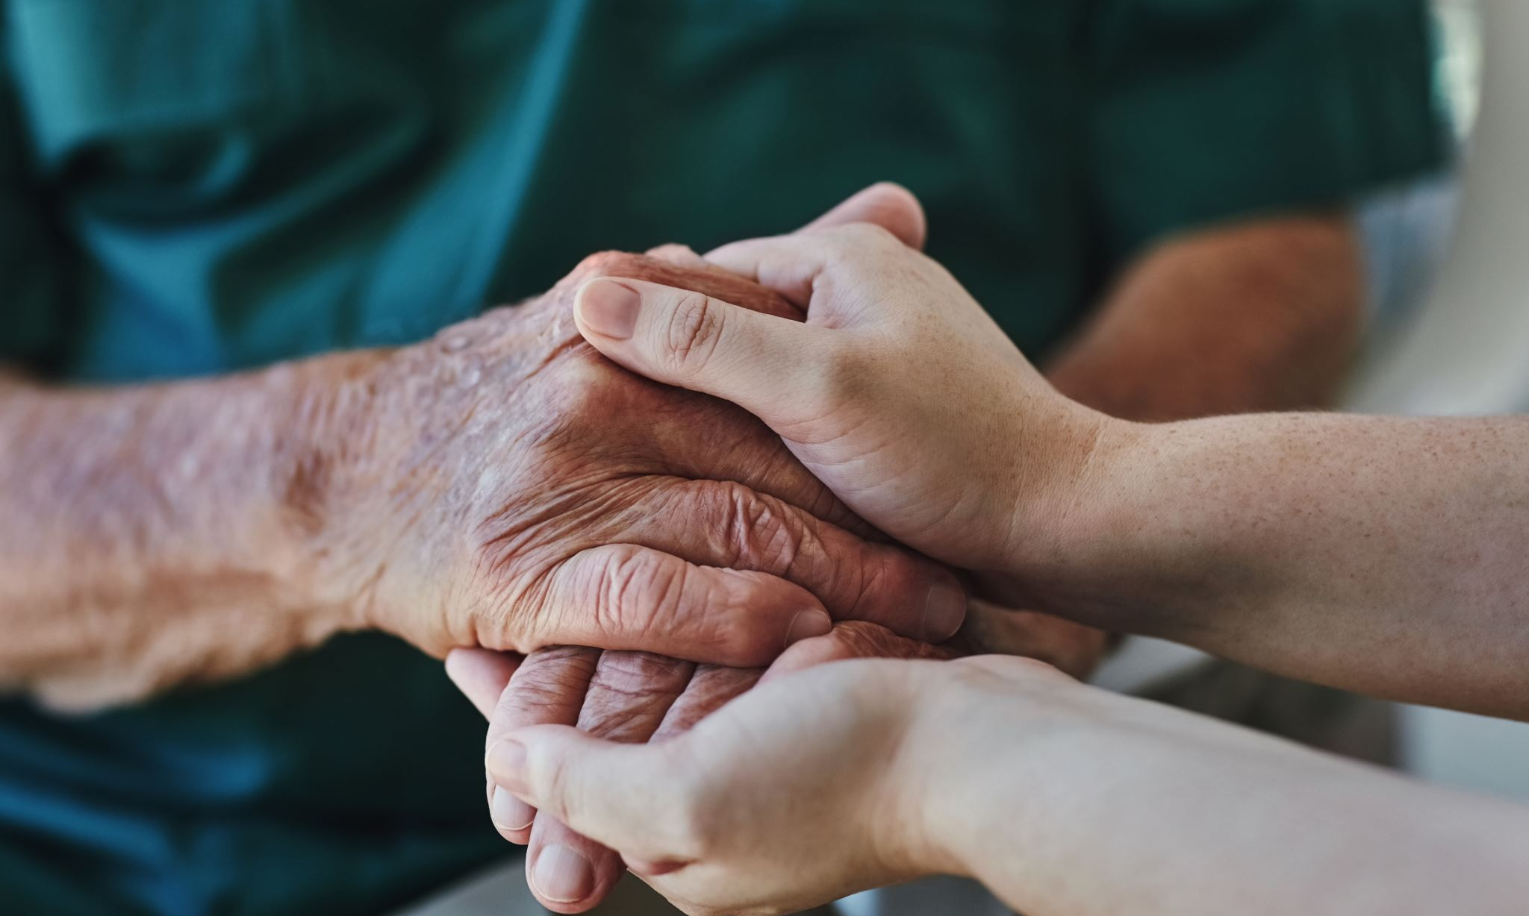
Steadfast family Support: Partner

Slide 17
My Wife, Grether
How PD Affected Our Relationship
My Wife and My Mother… a special relationship
My Partner's Support and Participation
Emotional Resources

Slide 18
Forever in out hearts

Slide 19
Steadfast family Support: Children

Slide 20
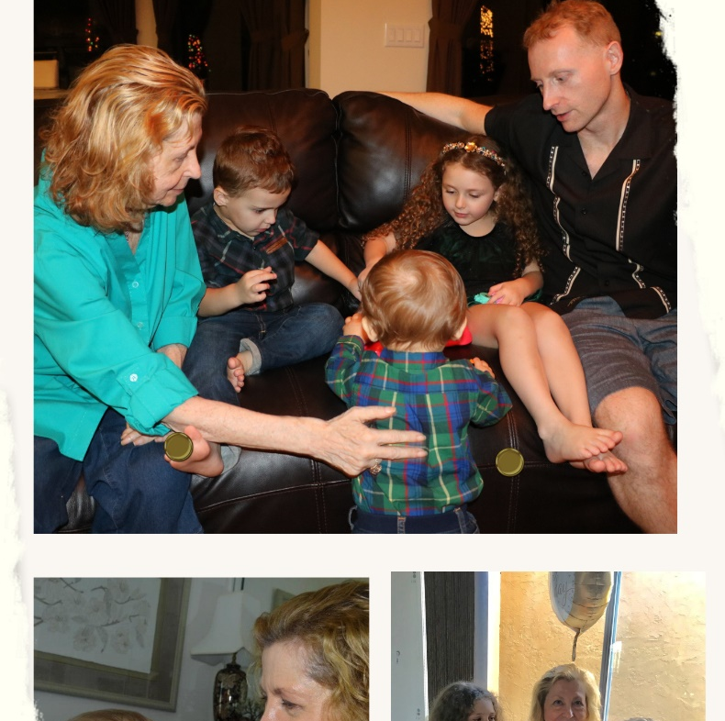
Our Children
Caring for the Children
The Children: Brooke
The Children: Joshua and Eli
Mom and the Children

Slide 21
Finally, Great Caregiving
There is no preparation to be a caregiver that could ever have prepared me.
Changed my life forever
Out of the darkness comes positive relationships
We fight on in memory of my mother but for those still battling PD today

Slide 22
The Final Week

Slide 23
December 2019- Heartbreaking
This past week, she has not been able to function. Reliance, the hospice, has taken over, and the nurses feel she has only days or hours left.
We still sit and wait . . . She has been breathing, and for six days now, with no food or water. Impossible. Still with us and so strong.
She is unable to speak, open her eyes, or eat. She is likely in pain around the clock, and the nurses can only keep giving her morphine. It is excruciating to see her like this and torture for us all.
January 1, 2020
Mom just passed away—6:05 p.m., January 1, 2020.
She can finally have peace.
And I am in shock . . .

Slide 24
The Aftermath
We remember…

Slide 25
Four months after mom passed…
Clearing Out
Wills
Power of Attorney
Fighting Back in her memory
A New Beginning

Slide 26
The Mission Forward

Slide 27
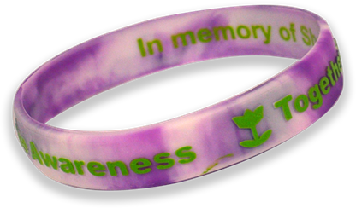
Relationships
Speaking out & a voice of awareness and hope for a cure in mom’s memory

Slide 28
Advocacy in my mother’s memory

Slide 29
Grateful To So Many

Slide 30
Continuing Onward
Ongoing Support Groups: Something Is Missing
What You Can Do
We love you; we support you, we care about you, and you are never alone!
I will continue to advocate for you.
Together our voices are so much stronger!
And I am just getting started!

Slide 31
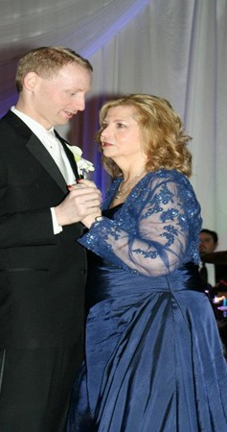
Thank You
Contact Information
togetherforsharon@gmail.com
https://www.togetherforsharon.com/
Social media https://linktr.ee/togetherforsharon

Slide 32
“One person can make a difference. One person can bring positive change.”
Let’s keep fighting until we end PD and find a Cure!
I will be advocating right by your side.
You can count on that!
Sharon’s son, George

Slide 33
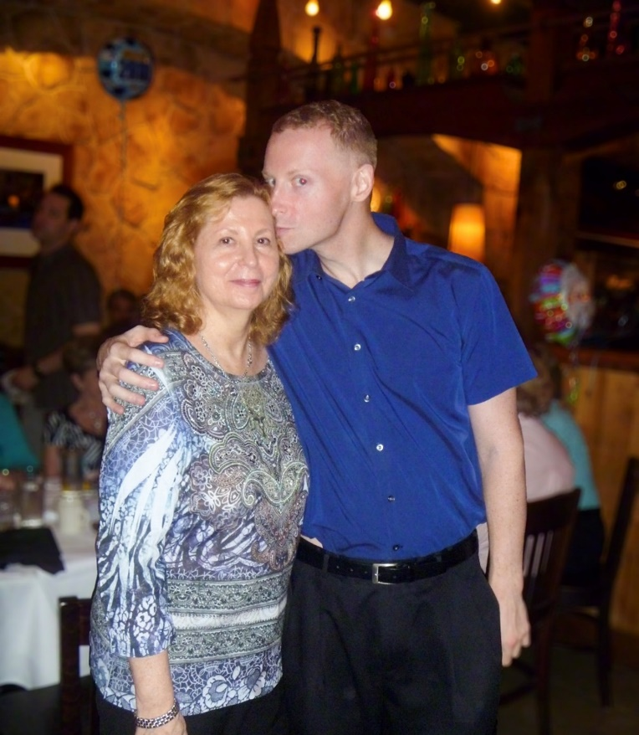
Thank you
My mother’s memory
lives on because of
you!

